Slide 1
COMP 90018 Mobile Computing Systems Programming
Tutorial on Android Development
Chu Luo, Eman Bin Khunayn
{chu.luo, eman.bin}@unimelb.edu.au

Slide 2
Welcome!
Outcomes of this tutorial:
Location API and Google services
Learn how to access your current geo position via the Android Location API a and how to display it on Google Maps.

Slide 3
Android Location API
Location
Location support classes: classes that your applications will use to get that information.
A Location instance consists of: Latitude, longitude, timestamp and, optionally, {accuracy, altitude, speed, and bearing}
Location Provider:
GPS, Cell phone towers, WiFi access points

Slide 4
1. Determines location based on cell tower
and WiFi access points.
Requires either
android.permission. ACCESS_COARSE_LOCATION
OR
android.permission.ACCESS_FINE_LOCATION
2. Determines location using GPS
Requires
android.permission.ACCESS_FINE_LOCATION

Slide 5
GPS – expensive, accurate, slower,
available outdoors
Network - cheaper, less accurate,
faster, availability varies

Slide 6
LocationManager Class
System service for accessing location data
getSystemService(Context.LOCATION_SERVICE)
Determine the last known user location
Register for location updates
Register to receive Intents when the device nears or moves away from a given geographic area

Slide 7
Installation
To use the location manager make the Google play service available via your app build.gradle file.
dependencies {
compile 'com.google.android.gms:play-services:9.2.0' compile 'com.google.android.gms:play-services-location:9.2.0'
}
Also specify the following required permission in your manifest.
<uses-permission android:name="android.permission.ACCESS_FINE_LOCATION"/>

Slide 8
Prompt the user to Enabled GPS
The user can decide if the GPS is enabled or not.
Using LocationManager is enabled via isProviderEnabled() method.
If its not enabled you can send the user to the settings via an Intent with the Settings. ACTION_LOCATION_SOURCE_SETTINGS

Slide 9
LocationListener Interface
Defines callback methods that are called when Location or LocationProvider status changes.
void onLocationChanged( Location location)
void onProviderDisabled(String provider)
void onProviderEnabled(String provider)
void onStatusChanged( String provider, int status, Bundle extras)

Slide 10
If your application cannot get a recent reading from the system, it will need to acquire its own reading and will normally perform the following steps:
1. Start listening for updates from location providers by registering a Location listener
2. Maintain and update a current best estimate as it begins to receive location updates
3.Determine when the current best estimate is good enough
4. Stop listening for location updates by unregistering the Location listener
5. Use that best estimate as the current location.

Slide 11
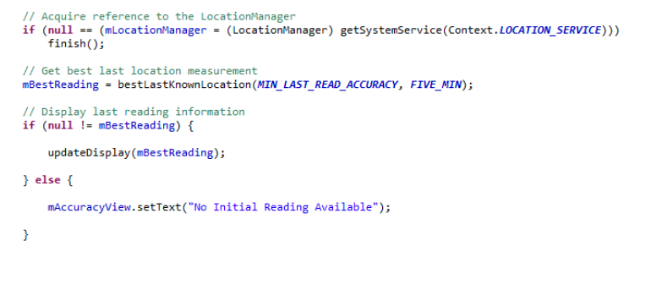

Slide 12
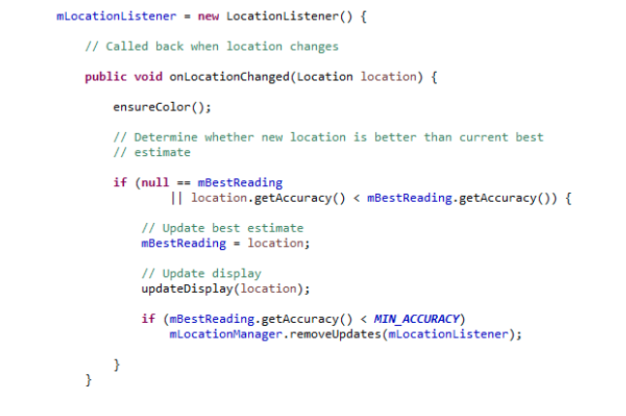

Slide 13
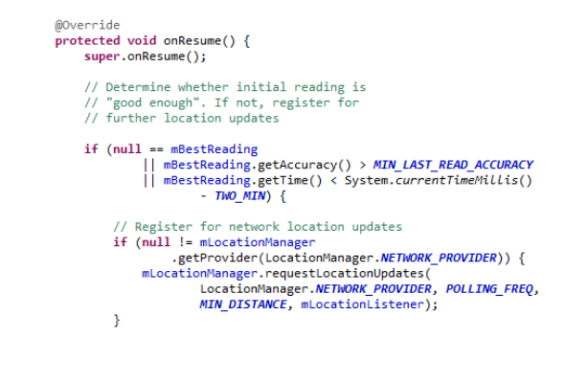

Slide 14
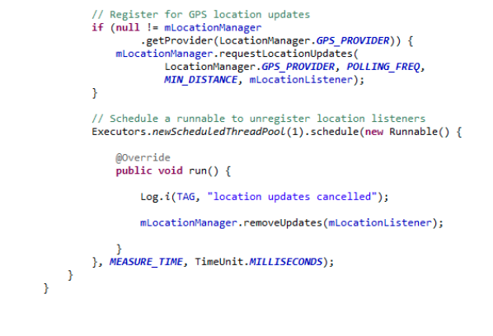

Slide 15
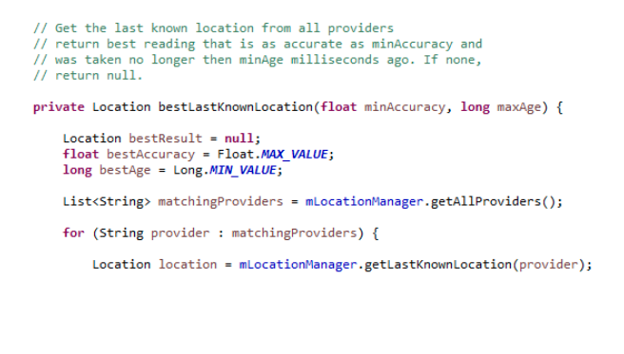

Slide 16
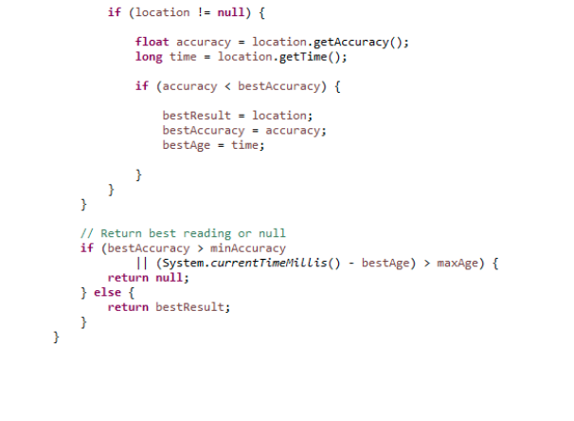

Slide 17
Maps
Map support classes: allow you to take location information. And display it visually to your users.
Android provides Mapping support through the Google Maps Android v2 API
Change the camera position
Add Markers & ground overlays
Respond to gestures
Indicate the user’s current Location

Slide 18
Map Classes:
GoogleMap
MapFragment
Camera
Marker

Slide 19
Setting Up Maps Application
Set up the Google Play services SDK
Obtain an API key
Specify settings in Application Manifest
Add map to project
See: https://developers.google.com/maps/documentation/android/start

Slide 20
Map permissions
<uses-permission android:name="android.permission.INTERNET"/>
<uses-permission android:name="android.permission.ACCESS_NETWORK_STATE"/>
<uses-permission android:name= "android.permission.WRITE_EXTERNAL_STORAGE"/>
<uses-permission android:name="com.google.android.providers.gsf.permission.READ_GSERVICES"/>

Slide 21
Example
Application acquires earthquake data from a server
then it displays the data on a map, using clickable markers

Slide 22
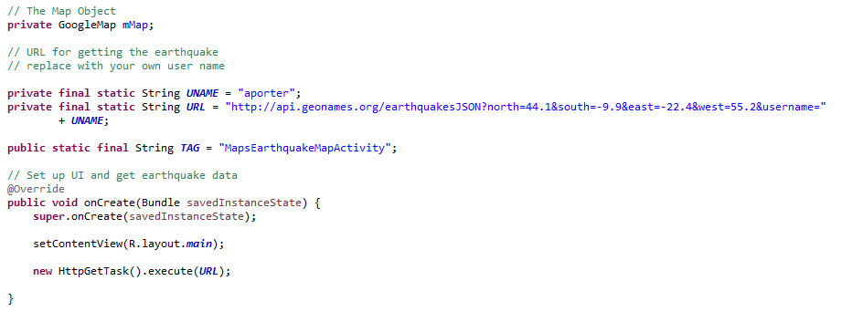

Slide 23
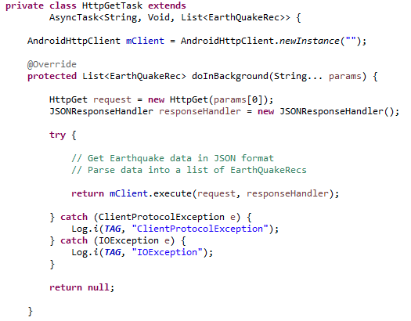

Slide 24
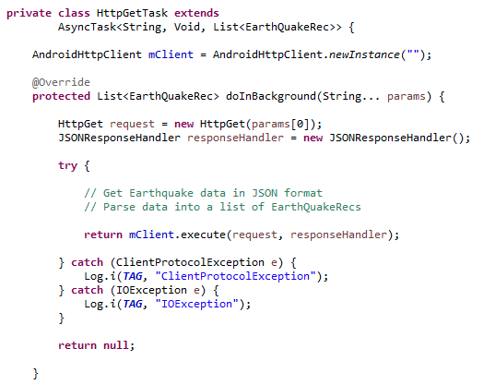

Slide 25
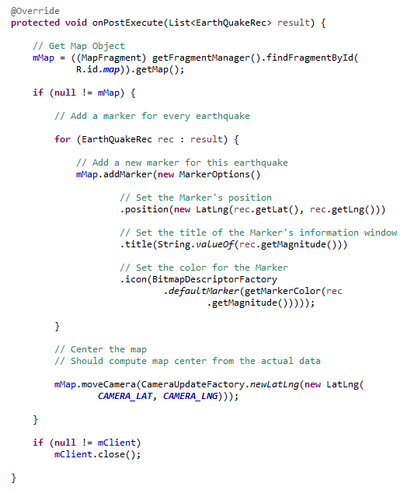

Slide 27
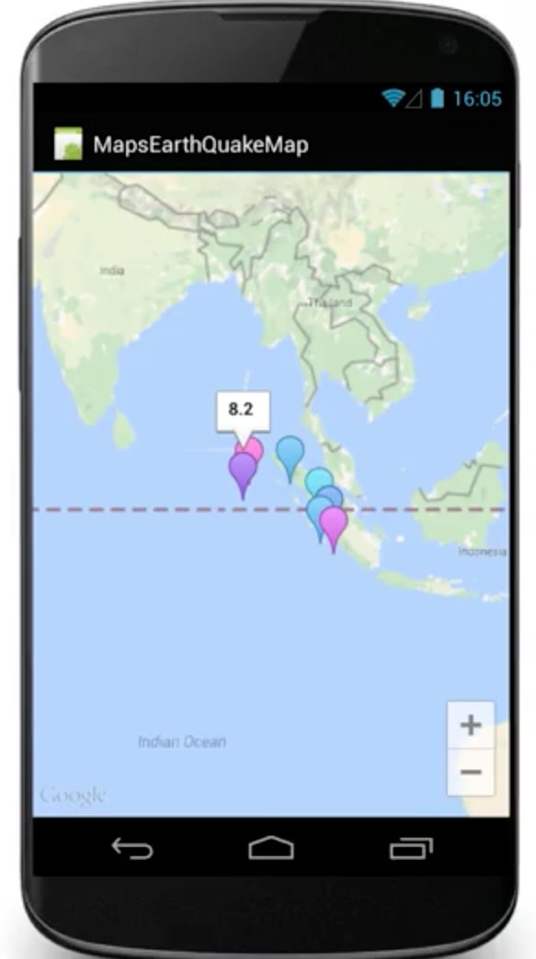

Slide 29
See you next week COMP 90018
Tutorial on Android Development
Chu Luo, Eman Bin Khunayn
{chu.luo, eman.bin}@unimelb.edu.au

